Slide 1
Engineering Cycle Worksheet
Jad Isidore
2021101043

Slide 2
1 DECOMPOSE the problem
What is the problem you are solving? What smaller problems can you break it into?
Big Goal:
Administer a four-question quiz to a user.
Subgoals:
This quiz should calculate the total number of correct answers and return feedback to the user based on number of marks attained.
This program also seeks to provide the user with reliable information in the form of a fun fact which will educate them.

Slide 3
1 DECOMPOSE the problem
Based on your understanding of the problem, make an educated guess about which coding concepts you will use.
Coding concepts:
I believe that I may have to use variables, functions and conditionals in this lab.

Slide 4
2 PLAN a solution
How should your algorithm solve the problem? Plan your solution in plain English or pseudocode.
First, I have to…
Establish all my variables.
Then I have to…
Provide the user with the necessary instructions about the program.

Slide 5
2 PLAN a solution
How should your algorithm solve the problem? Plan your solution in plain English or pseudocode.
In addition, I have to…
Lay out the questions and their choices below them, and also let the program know the answers for the following questions, so that if per chance the user enters the wrong answer the program will be aware.
Finally, I have to…
Keep track of the users’ marks/scores/points to be able to provide necessary feedback at the end of the four questions.

Slide 6
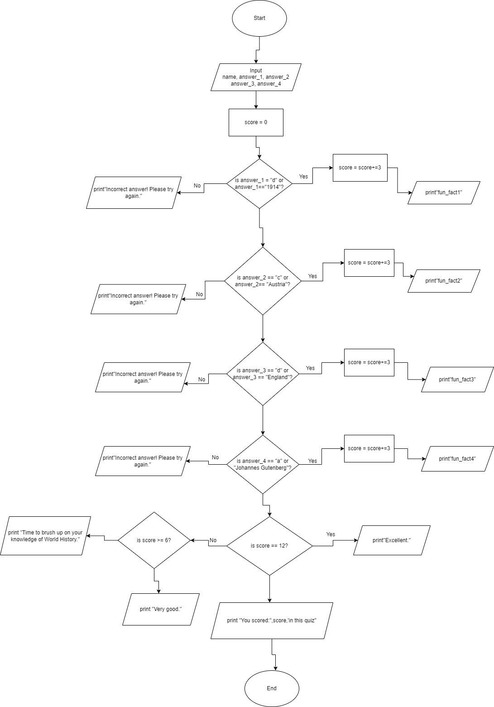
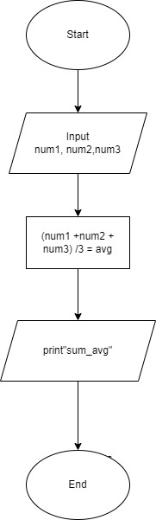
2 PLAN a solution

Slide 7
2 PLAN a solution
IPO Chart
INPUT | PROCESS | OUTPUT
name, answer_1 | if answer_1 == "d" or answer_1 == "1914“: print(“Correct”) | instruc
answer_2, answer_3 | if answer_2 == "c" or answer_2 == "Austria“: print(“Correct”) | fun_fact1
answer_4 | if answer_3 == "d" or answer_3 == "England“: print(“Correct”) | fun_fact2
 | if answer_4 == "a" or answer_4 == "Johannes Gutenberg“:print(“Correct”) | fun_fact3
 | score+= 1 | fun_fact4, player_feedback, score

Slide 8
3 IMPLEMENT the solution
def instruc():
print("Welcome!\nYou will be tested on 4 questions about World History. 3 marks are alloted\nfor each question you answer correctly.\nAll the best!")
name = input("Please enter your name to begin: ")
print("\nHello", name+ "🙂 Good Luck!\n")
fun_fact1 = "World War I, also known as the Great War, began in 1914 after\nthe assassination of Archduke Franz Ferdinand of Austria. His murder\ncatapulted into a war across Europe that lasted until 1918.During the\nconflict, Germany, Austria-Hungary, Bulgaria and the Ottoman Empire (the-\nCentral Powers) fought against Great Britain, France, Russia, Italy, Romania,\nCanada, Japan and the United States(the Allied Powers).\n(A&E Television Networks 2009)"

Slide 9
3 IMPLEMENT the solution
fun_fact2 = "Adolf Hitler was born in Braunau am Inn in Austria on April\n20th, 1889.(Biography.com Editors 2014)“
fun_fact3 = "By 1215, thanks to years of unsuccessful foreign policies and\nheavy taxation demands, England’s King John was facing down a possib-\nle rebellion by the country’s powerful barons. Under duress, he agreed\nto a charter of liberties known as the Magna Carta (or Great Charter) that\nwould place him and all of England’s future sovereigns within a rule of law.\n(History.com Editors 2009)“
fun_fact4 = "A printing press is a device for applying pressure to an inked\nsurface resting upon a print medium (such as paper or cloth), thereby\ntransferring the ink. It marked a dramatic improvement on earlier printing\nmethods in which the cloth, paper or other medium was brushed or rubbed\nrepeatedly to achieve the transfer of ink, and accelerated the process.\nTypically used for texts,

Slide 10
3 IMPLEMENT the solution
the invention and global spread of the printing\npress was one of the most influential events in the second millennium.\nJohannes Gutenberg, a goldsmith by trade, developed, circa 1439, a printing\nsystem by adapting existing technologies to printing purposes, as well as\nmaking inventions of his own.\n(H. Callum, Content Writer 2019)"
score = 0
# Instruction displayed for user
instruc()

Slide 11
3 IMPLEMENT the solution
# Storing questions into a function
# QUESTION 1
answer_1= input("1. World War 1 began in which year?\n (a) 1923 \n (b) 1938 \n (c) 1917 \n (d) 1914 \n Answer is: ")
if answer_1 == "d" or answer_1 == "1914":
print(" Correct!")
print("Fun fact: ",fun_fact1)
print("\n")
score += 3
else:
print("Incorrect answer! Please try again.")
print("\n")

Slide 12
3 IMPLEMENT the solution
# QUESTION 2
answer_2= input("2. Adolf Hitler was born in which country?\n (a) France \n (b) Germany \n (c) Austria \n (d) Hungary \n Answer is: ")
if answer_2 == "c" or answer_2 == "Austria":
print(" Correct!")
print("Fun fact: ",fun_fact2)
print("\n")
score += 3
else:
print("Incorrect answer! Please try again.")
print("\n")

Slide 13
3 IMPLEMENT the solution
# QUESTION 3
answer_3= input("3. The Magna Carta was published by the King of which country?\n (a) France \n (b) Austria \n (c) Italy \n (d) England \n Answer is: ")
if answer_3 == "d" or answer_3 == "England":
print(" Correct!")
print("Fun fact: ",fun_fact3)
print("\n")
score += 3
else:
print("Incorrect answer! Please try again.")
print("\n")

Slide 14
3 IMPLEMENT the solution
# QUESTION 4
answer_4= input("4. The first successful printing press was developed by this man.\n (a) Johannes Gutenberg \n (b) Benjamin Franklin \n (c) Sir Isaac Newton \n (d) Martin Luther \n Answer is: ")
if answer_4 == "a" or answer_4 == "Johannes Gutenberg":
print(" Correct!")
print("Fun fact: ",fun_fact4)
print("\n")
score += 3
else:
print("Incorrect answer! Please try again.")
print("\n")

Slide 15
3 IMPLEMENT the solution
# Feedback for player
def player_feedback():
if score == 12:
print("Excellent.")
elif score >= 6:
print("Very good.")
else:
print("Time to brush up on your knowledge of World History.")
player_feedback()
print('You scored:',score,'in this quiz')

Slide 16
4 TEST and DEBUG the code
Type your code into the code editor. Hit “run” to see if your code does what you intended. Make sure to check your spelling, syntax and structure. Type ‘x’ for which happens, add additional where applies.
X | Code works as intended
X | Everything is spelled correctly
X | Lines are properly indented
X | Parentheses () are correct
X | Capitalization is correct
X | Variables are defined before I use them
X | Function works as intended

Slide 17
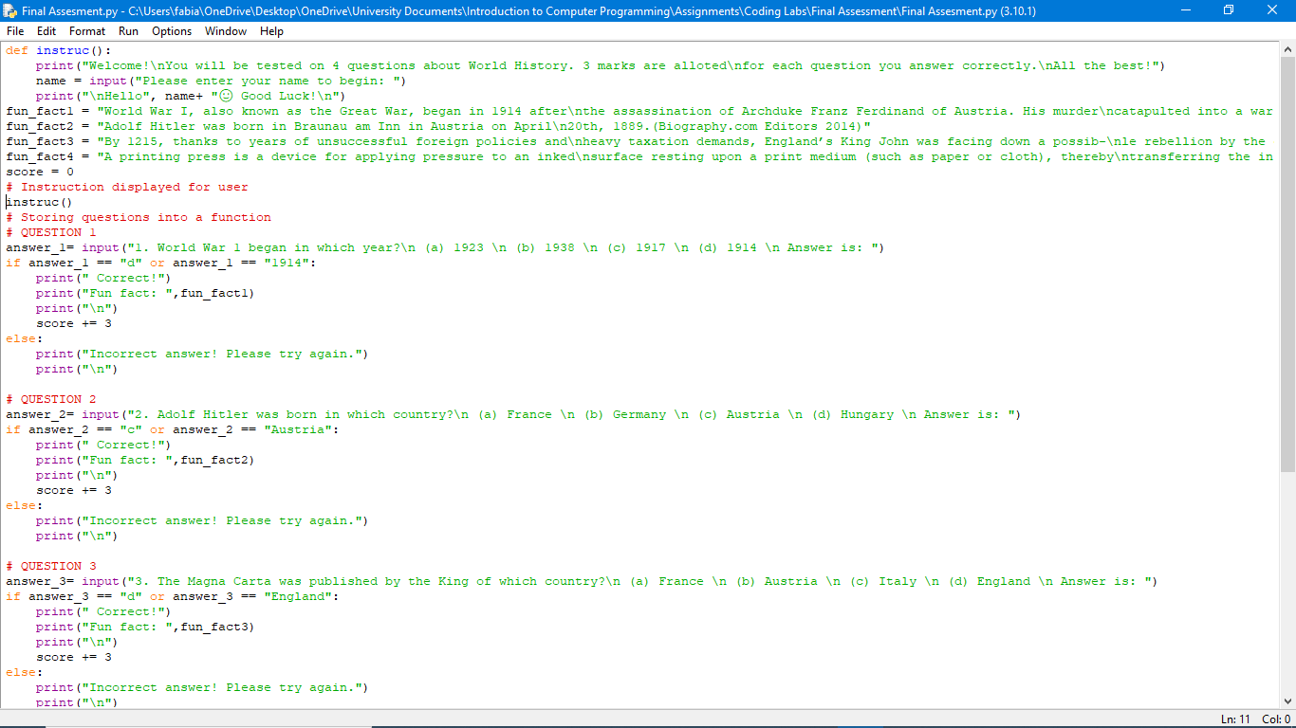
If you got no errors. Screenshot your code and the output and paste them onto this slide. If you got errors, please advance to the next slide

Slide 18
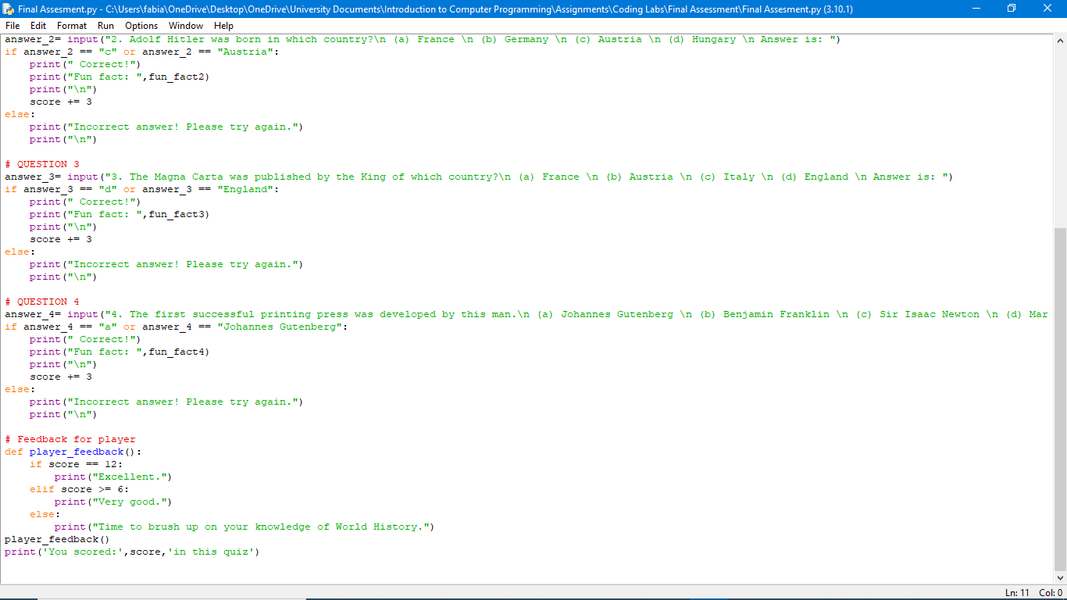

Slide 19
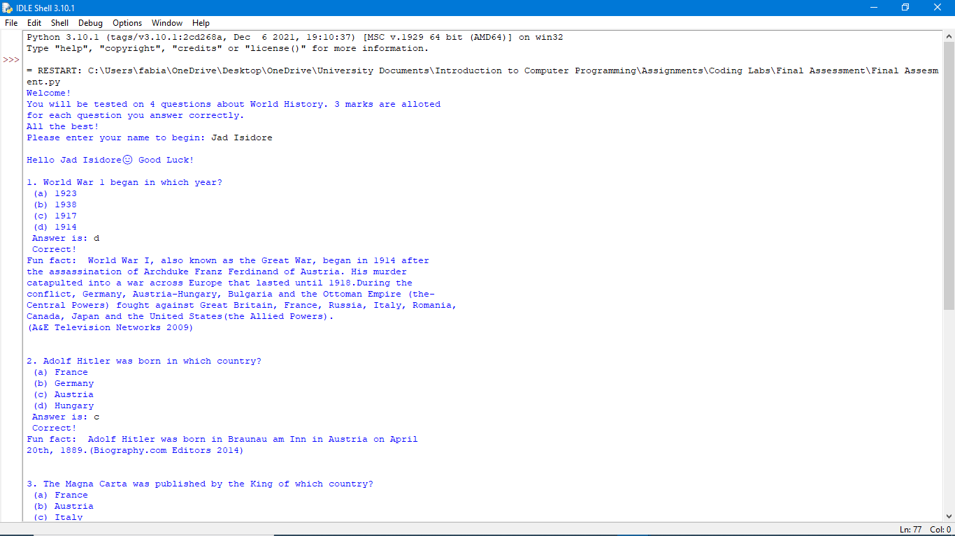

Slide 20
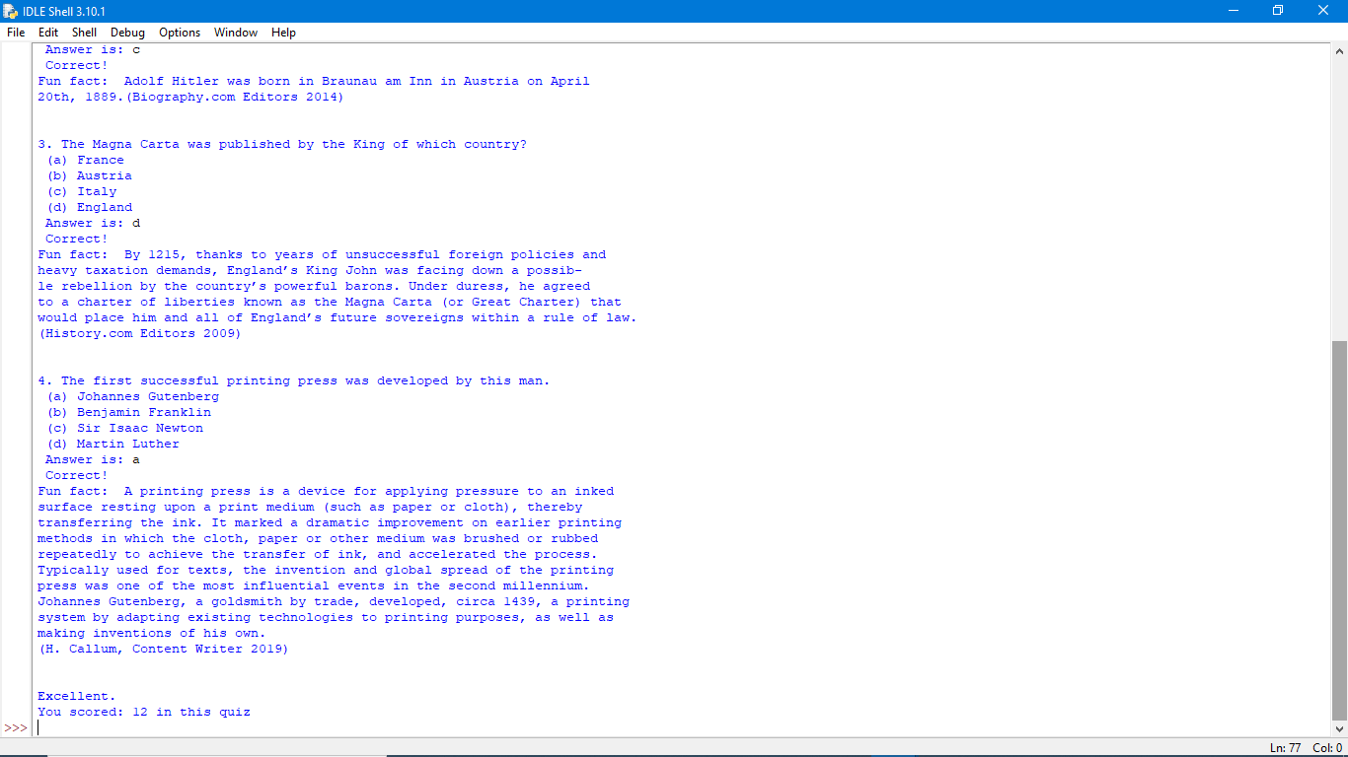

Slide 21
If you got errors. Screenshot your code and the error you got and paste them onto this slide.

Slide 22
What caused the error?

Slide 23
Screenshot the newly adjusted code and its output.

